Slide 1
Living things and their habitats
For parents
Thank you for supporting your child’s learning in science.
Before the session:
Please read slide 2 so you know what your child is learning and what you need to get ready.
As an alternative to using paper, slide 5 may be printed for your child to record on.
During the session:
Share the learning intentions on slide 2.
Support your child with the main activities on slides 3, 4 & 5, as needed.
Slide 6 is a glossary of key terms.
Reviewing with your child:
Slide 7 gives an idea of what your child may produce.
Making a mythical animal
Year 6 Age 10-11

Slide 2
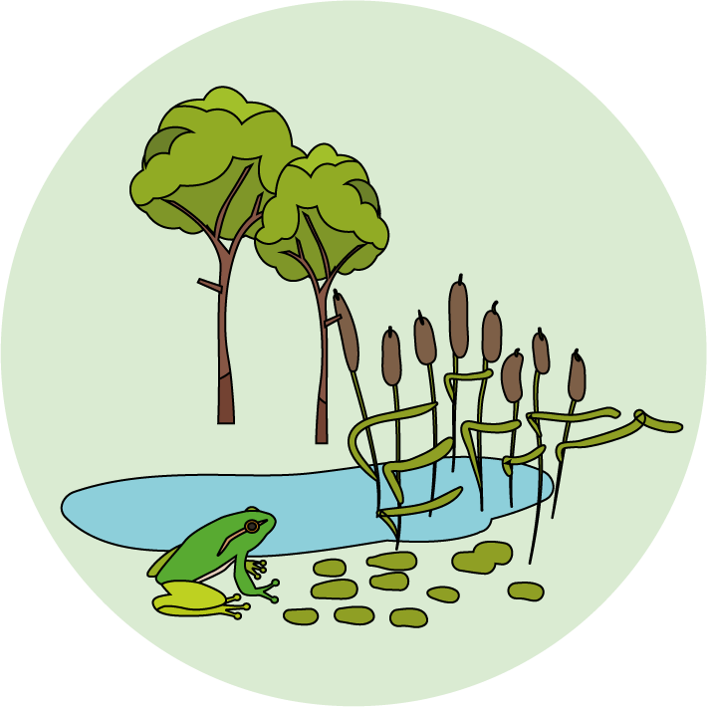
Living things and their habitats
Logo for section to sit inside roundel
Making a mythical animal
Key Learning
Living things can be grouped according to characteristics.
Some animals can be hard to classify when they appear to have features from more than one group.
Activities (pages 2-5): 30 - 40 mins
Use paper, a pencil and some coloured pencils/pens.
You may wish to print page 5.
I can…
Explain why classifying some animals, like a platypus, can be difficult.
Make up a mythical (fictional) animal with features from two or more different vertebrate groups.
2

Slide 3
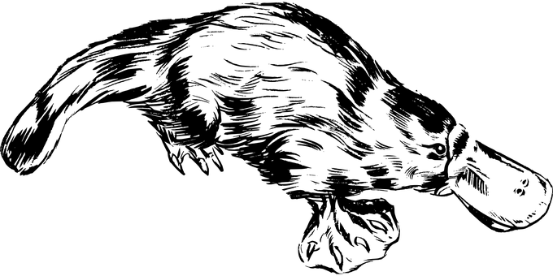
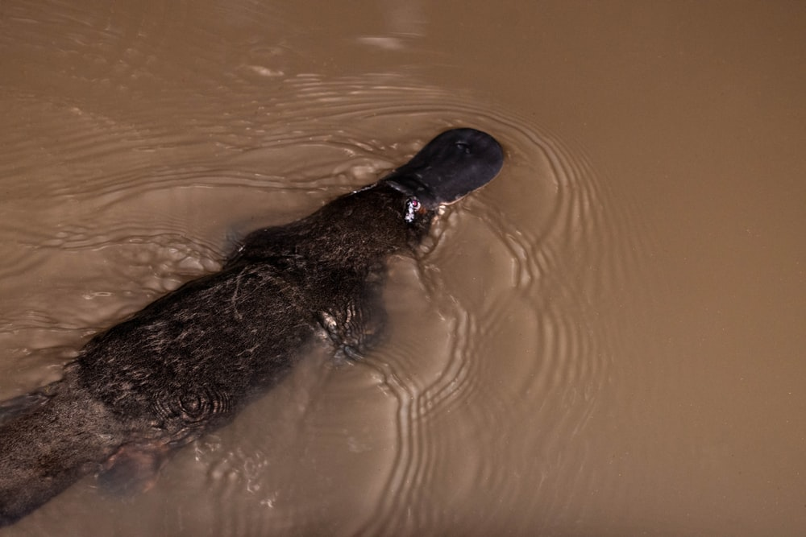
Explore, review, think, talk….
Logo for section to sit inside roundel
Find out about an unusual animal – the platypus
(10-15 minutes)
Watch this clip about the platypus.
https://www.tigtagworld.co.uk/film/why-do-we-classify-PRM00146/
Which two animals mentioned have features similar to a platypus?
Which vertebrate group does a platypus belong to?
This second clip, narrated by David Attenborough, gives more details about how a platypus breeds.
https://www.bbc.co.uk/programmes/p004jl2c
Try jotting down some ideas as you watch.
Talk or think about why scientists found it difficult to classify the platypus.
3

Slide 4
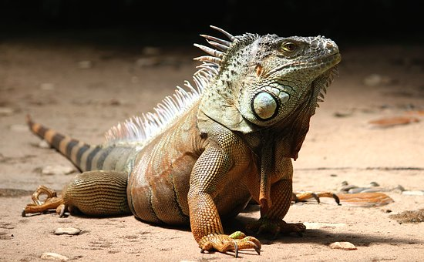
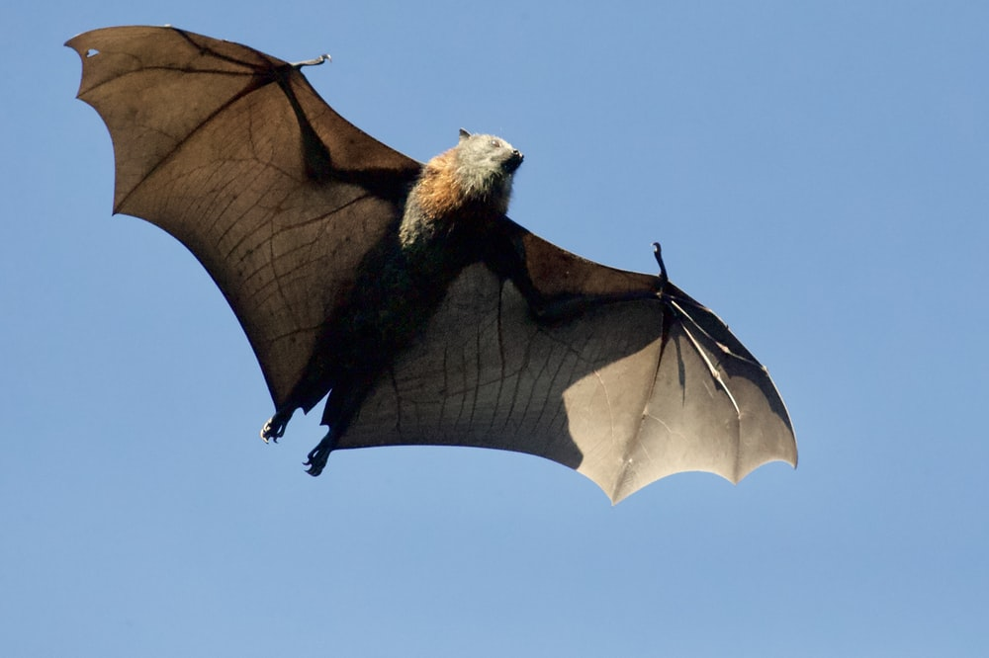
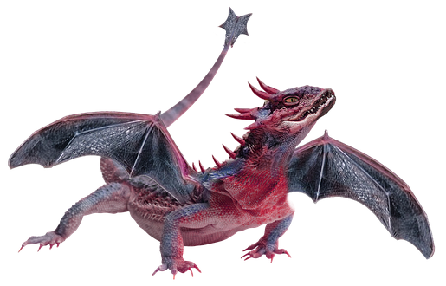
Features of mythical animals
Logo for section to sit inside roundel
Mythical animals often have features from more than one animal group
(page 4-5: 20-30 minutes)
Talk or think about the features of a dragon.
Which animals do you think have features or characteristics similar to a dragon?
Dragons are sometimes drawn with scales like a reptile and wings like a bat.
How do we know when an animal is mythical or fictional?
Watch this clip about Carl Linnaeus. https://youtu.be/lmQVnEMWtFc
In the past, scientists were able to recognise fictional animals when they appeared to have features from different groups.
4

Slide 5
Create a mythical vertebrate creature and label its features:
Has it got fur, hair, scales, feathers or a smooth moist skin?
Has it got legs, wings, fins or a tail?
Does it live on land or in water?
Does it breathe air with lungs or use gills?
Is it warm or cold blooded?
Does it lay eggs or give birth to live young?
Describe which animals your creature might be related to.
I can make up a mythical animal with features from two or more different vertebrate groups.
5

Slide 6
Glossary of terms
Characteristic: Characteristics are features of living things which help scientists classify them.
Classification: Classification is the method scientists use to group living things.
Vertebrate: A vertebrate is an animal with a backbone.
6

Slide 7
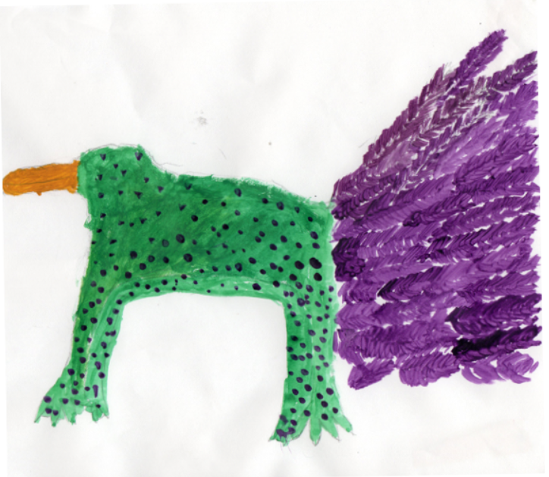
Possible learning outcome for reviewing your work.
I can make up a mythical animal with features from two or more different vertebrate groups.
Pupil comments:
“it has moist skin, webbed feet and lives on land and in the water.”
“It has a beak and a feathered tail.”
“it is warm blooded and gives bird to live young.”
This pupil has chosen features of a bird (warm blooded, feathers and a beak), an amphibian (moist skin and webbed feet) and a mammal (warm blooded and gives birth to live young)
7

